Slide 1
PROFESSIONAL ETHICS (HUT 200)
Module III
ENGINEERING AS SOCIAL EXPERIMENTATION

Slide 2
Syllabus
Engineering as Experimentation – Engineers as responsible Experimenters- Codes of Ethics- Plagiarism-A balanced outlook on law - Challenges case study- Bhopal gas tragedy.

Slide 3
Introduction
The process of engineering lets you go through a series of different experiments when it comes to practical use.
Though it is not like an experiment in laboratory under controlled conditions, which is done while learning, an engineer should be ready to do the same on a social scale involving human subjects.
Experimentation plays an important role in the process of designing the product.

Slide 4
Engineering as Experimentation
Experimentation plays an important role in the process of designing the product.
When it is decided to change a new engineering concept into its first rough design;
Preliminary tests or simulation should be conducted.
Using formal experimental methods, the materials and methods of designing are tried out.
These tests may be based on more detailed designs.
The test for designing should be evolved till the final product produced.
With the help of feedback of several tests, further modification can be made if necessary.
Beyond these tests and experiments, each engineering project has to be viewed as an experiment.

Slide 5
Similarities to Standard Experiments
Partial ignorance
Engineers don't have all the needed facts available well in advance before starting the project.
Uncertainties in outcome
Final outcomes of engineering projects are generally uncertain like that of experiments.
Eg: model used for design calculation, exact characteristics of the materials purchased etc.
Continuous monitoring
good and effective engineering depends upon the knowledge possessed about the products at the initial and end stages.
The monitoring is done by making periodic observations and tests.
Learning from the past

Slide 6
Differences with Standard Experiments
Experimental Control - standard experiments are done in a controlled environment whereas engineers do their experimentation on a social scale keeping in mind of the end consumers using the product.
Humane touch - in engineering the experimental subjects are human beings who are out of the control of the experimenters.
Informed consent
The knowledge about the product
Risks and benefits of using the product and
All relevant information on the product, such as how to use and how not to use (do’s and don’ts).
Knowledge and voluntariness
Knowledge gained
Scientific experiments have been conducted to acquire new knowledge. Whereas engineering projects are conducted as experiments not for getting new knowledge. Suppose the outcomes of the experiment is best, it tells us nothing new, but merely affirms that we are right about something. Meanwhile, the unexpected outcomes put us search for new knowledge.

Slide 7
ENGINEERS AS RESPONSIBLE EXPERIMENTERS
In the process of developing a product, an engineer generally learns through experimentation.
A trial and error method is the mostly widely used method.
An engineer should always be ready for the unexpected output. Nothing is really predictable.
Engineers share a greater responsibility while monitoring the projects, identifying the risks, and informing the clients and the public with facts.
Based on this, they can take decisions to participate or protest or promote.

Slide 8
Responsibility of Engineers in Experimentation
Conscientiousness ( Sense of awareness)
Conscientiousness implies consciousness which means the sense of awareness.
Every engineer is expected to have some moral standards irrespective of the role he is performing.
Along with satisfying the employer’s goals, by behaving as a responsible employee, by not doing any fraud, not breaking confidentiality and violating patent rights etc., an engineer should be conscious about the unexpected. Adverse outcome may come up as unexpected result of their experiments; for this, they are answerable to the public.
Comprehensive Perspective/Informed Consent
The engineer should grasp the context of his work and ensure that the work involved results in only moral ends.
The engineered products of the company should be in such a way that they can never be used to perform any illegal or unsocial activities, which causes destruction.

Slide 9
Continued..
Moral Autonomy
Any person can be morally autonomous only when one is being genuine in one’s commitment towards moral values.
Moral beliefs and attitudes must be integrated into an individual’s personality which leads to a committed action.
The responsibility to answer an unexpected result, influences an engineer to involve himself personally into the work. This leads to moral autonomy wherein, he also gains the trust of the employer, through his commitment.
Accountability/(Moral responsibility)
Accountability can be understood as the moral responsibility that we have towards our actions.
It means a tendency to be willing to openly accept the moral examinations towards one’s actions and being responsive to the assessment of others.

Slide 10
CODES OF ETHICS
The ‘codes of ethics’ exhibit, rights, duties, and obligations of the members of a profession and a professional society.
The codes exhibit the following essential roles/functions:
Serving and protecting the public
Guidance
Inspiration
Shared Standards
Support for responsible professionals
Education and Mutual understanding
Deterrence (discourage to act immorally) and discipline (regulate to act morally).
Contributing to the profession’s image

Slide 11
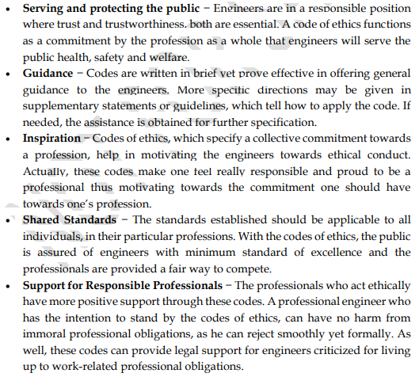

Slide 12
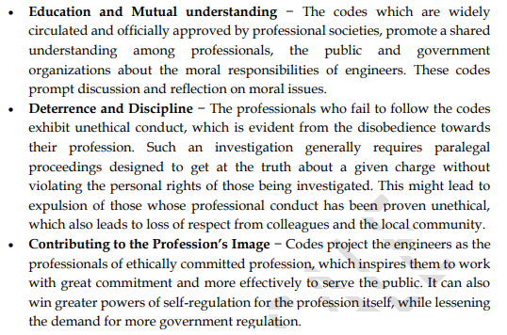

Slide 13
Advantages(Why Code of ethics is important)
Set out the ideals and responsibilities of the profession.
Exert a de facto regulatory effect protecting both clients and professionals.
Improve the profile of the profession.
Motivate and inspire practitioners
Provide guidance.
Raise awareness and consciousness of issues.
Improve quality and consistency.

Slide 14
Limitations
General and vague wordings
Not applicable to all situations
Often have internal conflicts
Can not be treated as final moral authority for professional conduct
Only a few enroll as members in professional society
Many are unaware of the codes
Different societies have different codes.
Sometimes claimed to be threatening and forceful.

Slide 15
PLAGIARISM
Stanford sees plagiarism as the "use, without giving reasonable and appropriate credit to or acknowledging the author or source, of another person's original work, whether such work is made up of code, formulas, ideas, language, research, strategies, writing or other form.“
Princeton perceives plagiarism as the "deliberate" use of "someone else's language, ideas, or other original (not common-knowledge) material without acknowledging its source.“
Oxford characterizes plagiarism as the use of "a writer's ideas or phraseology without giving due credit.“
Plagiarism can occur in many forms (writing, art, music, computer code, mathematics etc.,)
What we call originality is actually the innovative combining, amending, or extending of material from that pool.

Slide 16
Avoid Plagiarism
Always distinguish between what has been learned from others and what is being personally contributed to the reader's understanding.
It is important to understand how to attribute words and ideas which are use to their proper source.
Must learn how to declare intellectual debts.
Proper attribution acknowledges those debts responsibly, usefully, and respectfully.

Slide 17
A BALANCED OUTLOOK ON LAW
To live in harmony in the society, one should learn to maintain a balance between individual needs and collective needs of the society.
The ‘balanced outlook on law’ in engineering practice stresses the necessity of laws and regulations and also their limitations in directing and controlling the engineering practice.
Laws are needed to provide a minimum level of compliance

Slide 18
Examples
Babylon’s Building Code (1758 BC) set by Hammurabi, king of Babylon.
It aimed at the builders of his time.
“If a builder has built a house for a man and has not made his work sound, and the house which he has built was fallen down and so caused the death of the householder, that builder shall be put to death. If it causes the death of the house holder’s son, they shall put that builder’s son to death. If it causes the death of the house holder’s slave, he shall give slave to the householder.
If it destroys property, he shall replace anything it has destroyed; and because he has not made the house sound which he has built and it has fallen down, he shall rebuild the house which has fallen down from his own property. If a builder has built a house for a man and does not make his work perfect and the wall bulges, that builder shall put that wall into sound condition at his own cost”.

Slide 19
Continued..
The United States Steamboat Code (1852 AD):
The steam engines used for travel during those days were really heavy and bulky with a major problem of boiler explosions.
The speed of the boats if increased led to the explosion of the boilers on steam boats causing disasters
Alfred Guthrie, an engineer of Illinois had inspected around 200 steam boats with his own funding and found out the reasons for the boiler explosions and later prepared a report relating to the care that could be taken later.
The recommendations were published by Senator Shields of Illinois and incorporated in senate documents which later was made a law, which made the ASME, to formulate the standards in the manufacturing of steam boats.

Slide 20
The Challenger Case study
Explosion of the space shuttle ‘Challenger’
This case had been reviewed vigorously by mediacoverage, government reports and transcripts of hearings. This case deals with many ethical issues which engineers faced.
It poses many questions before us. A few questions are listed below
What is the exact role of the engineer when safety issues are concerned?
Who should have the ultimate authority for decision making to order for a launch?
Whether the ordering of a launch be an engineering or a managerial decision?

Slide 21
The Challenger Case study contd.
Challenger space shuttle mainly consisted of an orbiter, two solid propellant boosters and a single liquid-propeller booster, which was actually designed to be a reusable one. All the boosters were ignited and the orbiter took a lift-off from the earth. But the cold temperature caused trouble to the O-rings which were eroded.
The accident took place on 28th January 1986,due to the failure of one of the solid boosters. In the design of the space shuttle, the main parts which needed careful design of the fields joints where the individual cylinders were placed together.

Slide 22
Challenger Case study contd.
President Regan appointed a commission called the Rogers Commission which constituted of many distinguished scientists and engineers.
The investigation results shows how lack of responsibility and morality, improper functions, and lack of performance of duties of the engineers resulted in the crash.

Slide 23
The Challenger Case study : Inferences
Moral/Normative Issues
The crew had no escape mechanism. A ‘safe exit’ was rejected as too expensive
The crew were not informed of the problems existing in the field joints.
Engineers gave warning signals on safety. But the management group prevailed over and ignored the warning.

Slide 24
The Challenger Case study : Inferences
Conceptual Issues
NASA counted that the probability of failure of the craft was one in one lakh launches.
There were 700 criticality items, which included the field joints. A failure in any one of them would have caused the tragedy.
No back-up or stand-by had been provided for these criticality components.

Slide 25
The Challenger Case study : Inferences
Factual/Descriptive Issues
Field joints gave way in earlier flights. But the authorities felt the risk is not high.
NASA has disregarded warnings about the bad weather, at the time of launch, because they wanted to complete the project, prove their supremacy, get the funding from Government continued and get an applaud from the President of USA.

Slide 26
BHOPAL GAS TRAGEDY
Bhopal’s Gas tragedy is the world’s worst industrial disaster that occurred in 1984, due to the gas leakage from a pesticide production plant, The Union Carbide India Limited (UCIL)located in Bhopal, Madhya Pradesh.
It was believed that slack management and deferred maintenance together created a situation where routine pipe maintenance caused a backflow of water into the MIC tank, triggering the disaster.

Slide 27
BHOPAL GAS TRAGEDY
It was understood that a large volume of water had been released into the MIC tank and this further caused a chemical reaction that forced the pressure release valve to open and allowed the gas to leak
As per government’s announcement, a total of 3,787 deaths occurred immediately. Around 8,000 of the survivors died within two weeks and other 8,000 or more died from acute diseases caused due to the gas
later.

Slide 28
University Questions
What are the essential conditions for a valid informed consent?(3)
List out the limitations of Codes of Ethics. (3)
Why are codes of ethics important? (3)
Explain the term “Balanced outlook on law” (3)
What are the features of morally responsible Engineering Experimenters? (3)
What is the role of codes of ethics? (3)
Describe the causes and fatal effects of Bhopal Gas Tragedy (7)
Illustrate the role of engineers as experimenters. (7)
Evaluate the importance of accountability in a professional’s life. (6)
Explain the role of Codes of Ethics in the service life of a professional Engineer. (8)
What are the different roles and functions of “Code of ethics”? (14)

Slide 29
12. Explain the Bhopal gas tragedy. Discuss the violation of moral, ethics, and professional codes of standards in it. (14)
13. What are the similarities between engineering experiments and standard experiments? (7)
14. What is the significance of Industrial Standards? List the advantages of industrial standards? (7)
15. What does the ‘balanced outlook on law’ stress in engineering profession? (7)
16. What are the safety lessons that we can be learned from space shuttle challenger tragedy? (7)

